Slide 1
Microsoft Fabric How to keep our items and data safe?!

Slide 2
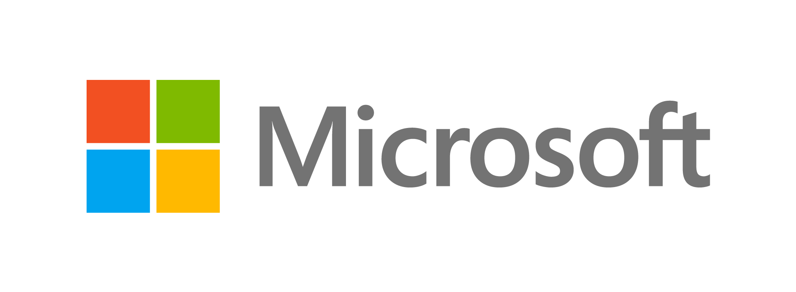

Special thanks to Fabric and Power BI Team at
This Summit presented to you by

Slide 3
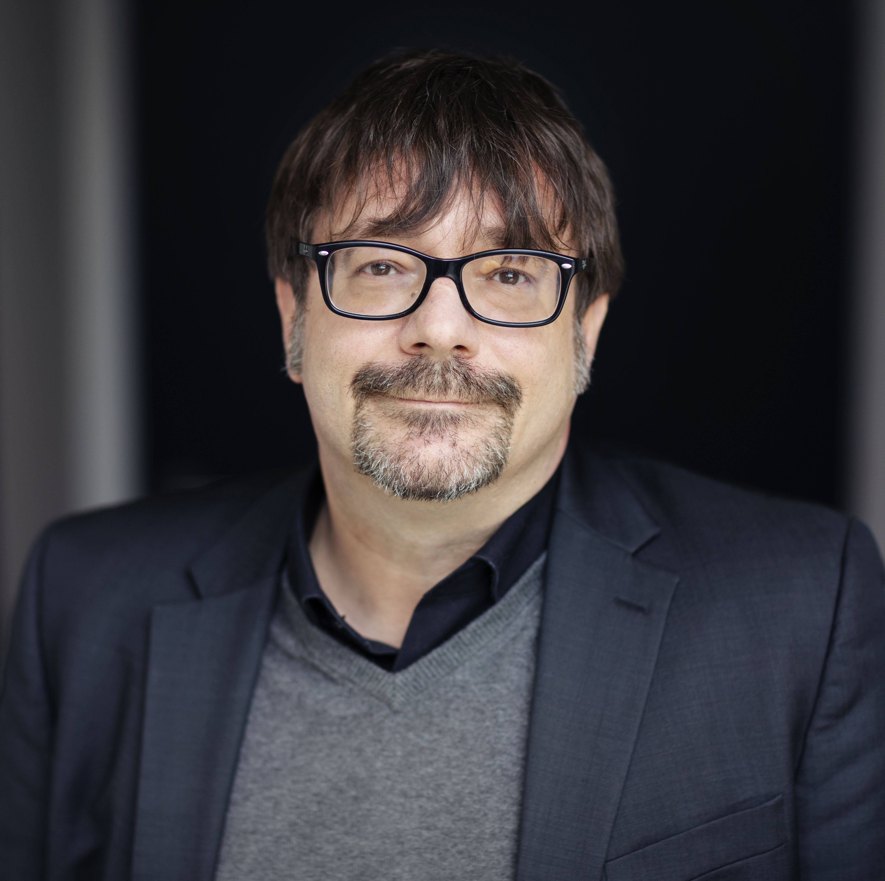
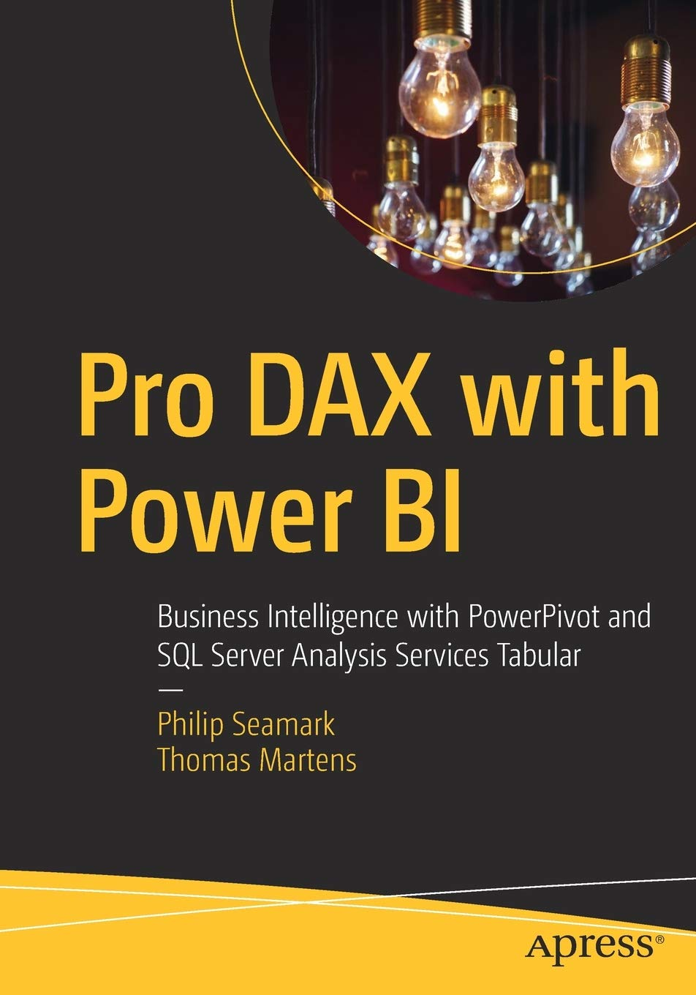
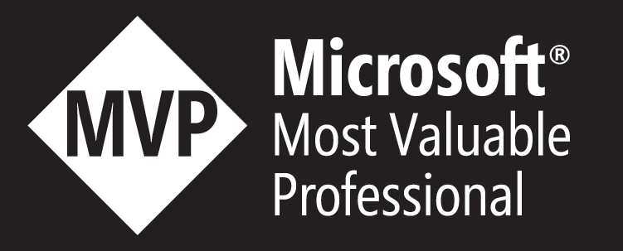
25+ years of experience designing analytical solutions using the MSFT data platform
Tom Martens
Solution Architect @ Munich Re
/tommartens68
@tommartens68

Slide 4
Inside the box
Power BI Recap (a quick look behind)
Microsoft Fabric is entering the stage
Risk mitigation by organizing our Fabric workloads
A gentle introduction to Azure Security capabilities
Restrict access to tables in the Warehouse item

Slide 5
Power BI recap (a quick look behind)

Slide 6
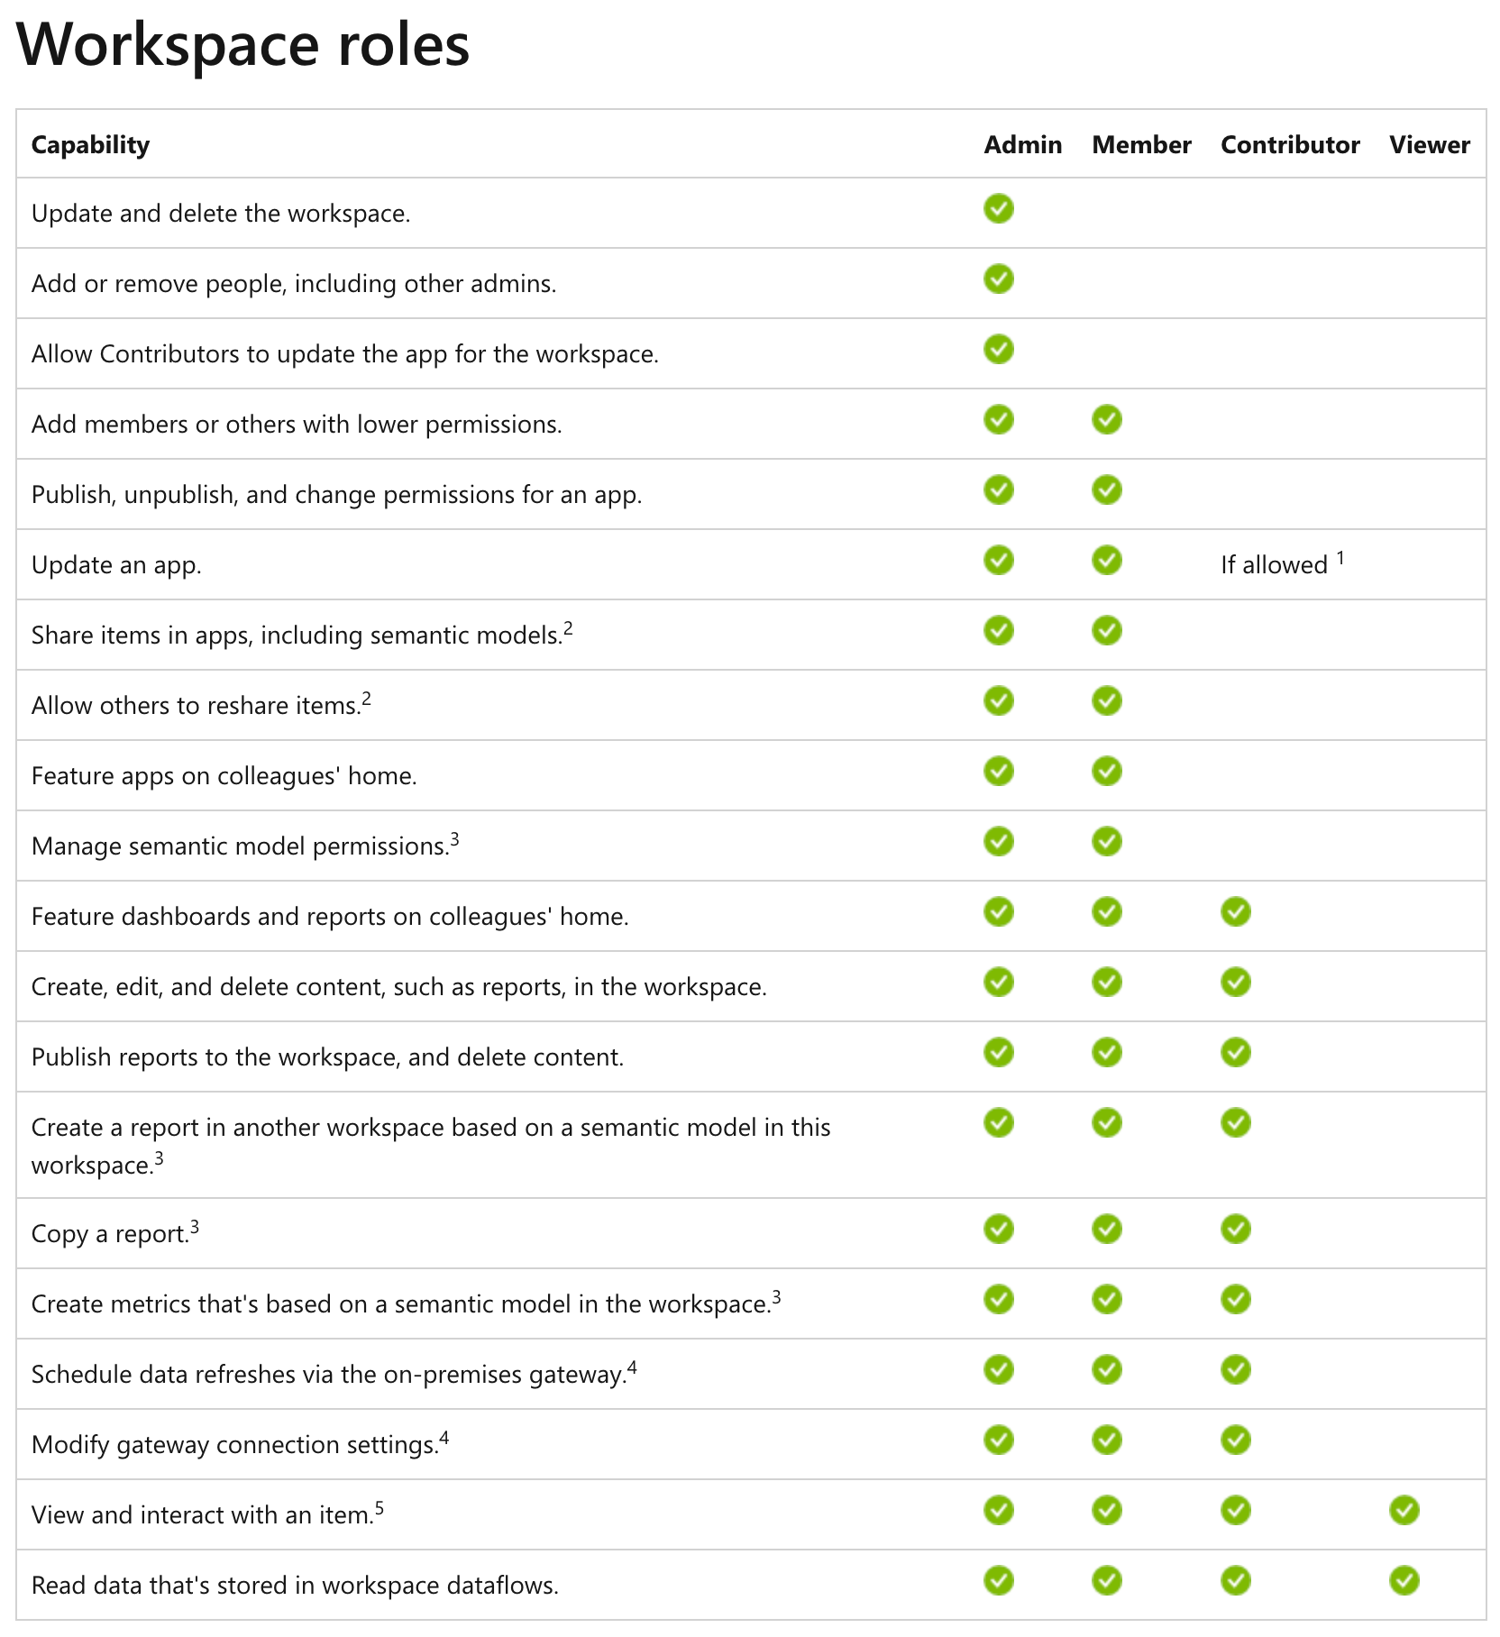

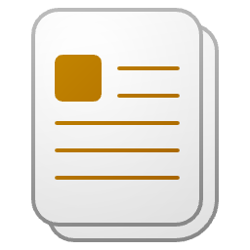




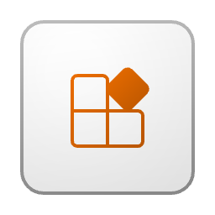


Power BI recap (a quick look behind)

Slide 7
Microsoft Fabric is entering the stage

Slide 8





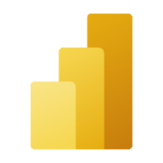


Microsoft Fabric
Unified analytics platform
Lake centric and open
Empower every Office user
Pervasive security and governance
Data
Factory
Synapse Data
Engineering
Synapse Data Warehouse
Synapse Data Science
Synapse Real Time Analytics
Power BI
Data Activator
OneLake

Slide 9

Microsoft Fabric
All the compute engines store their data automatically in OneLake
The data is stored in a single common format
Delta – Parquet, an open standards format, is the storage format for all tabular data in Analytics vNext
Once data is stored in the lake, it is directly accessible by all the engines without needing any import/export
All the compute engines have been fully optimized to work with Delta Parquet as their native format
Shared universal security model is enforced across all the engines
Data
Factory
Synapse Data
Engineering
Synapse Data
Science
Synapse Data Warehousing
Synapse Real Time Analytics
Power BI
Data Activator
Serverless
Compute
Spark
T-SQL
KQL
Analysis Services
OneLake
Customers 360
Finance
Service Telemetry
Business KPIs
Delta – Parquet Format
Delta – Parquet Format
Delta – Parquet Format
Delta – Parquet Format

Slide 10
Our world has become more complex
Risk mitigation by organizing our Fabric workloads

Slide 11
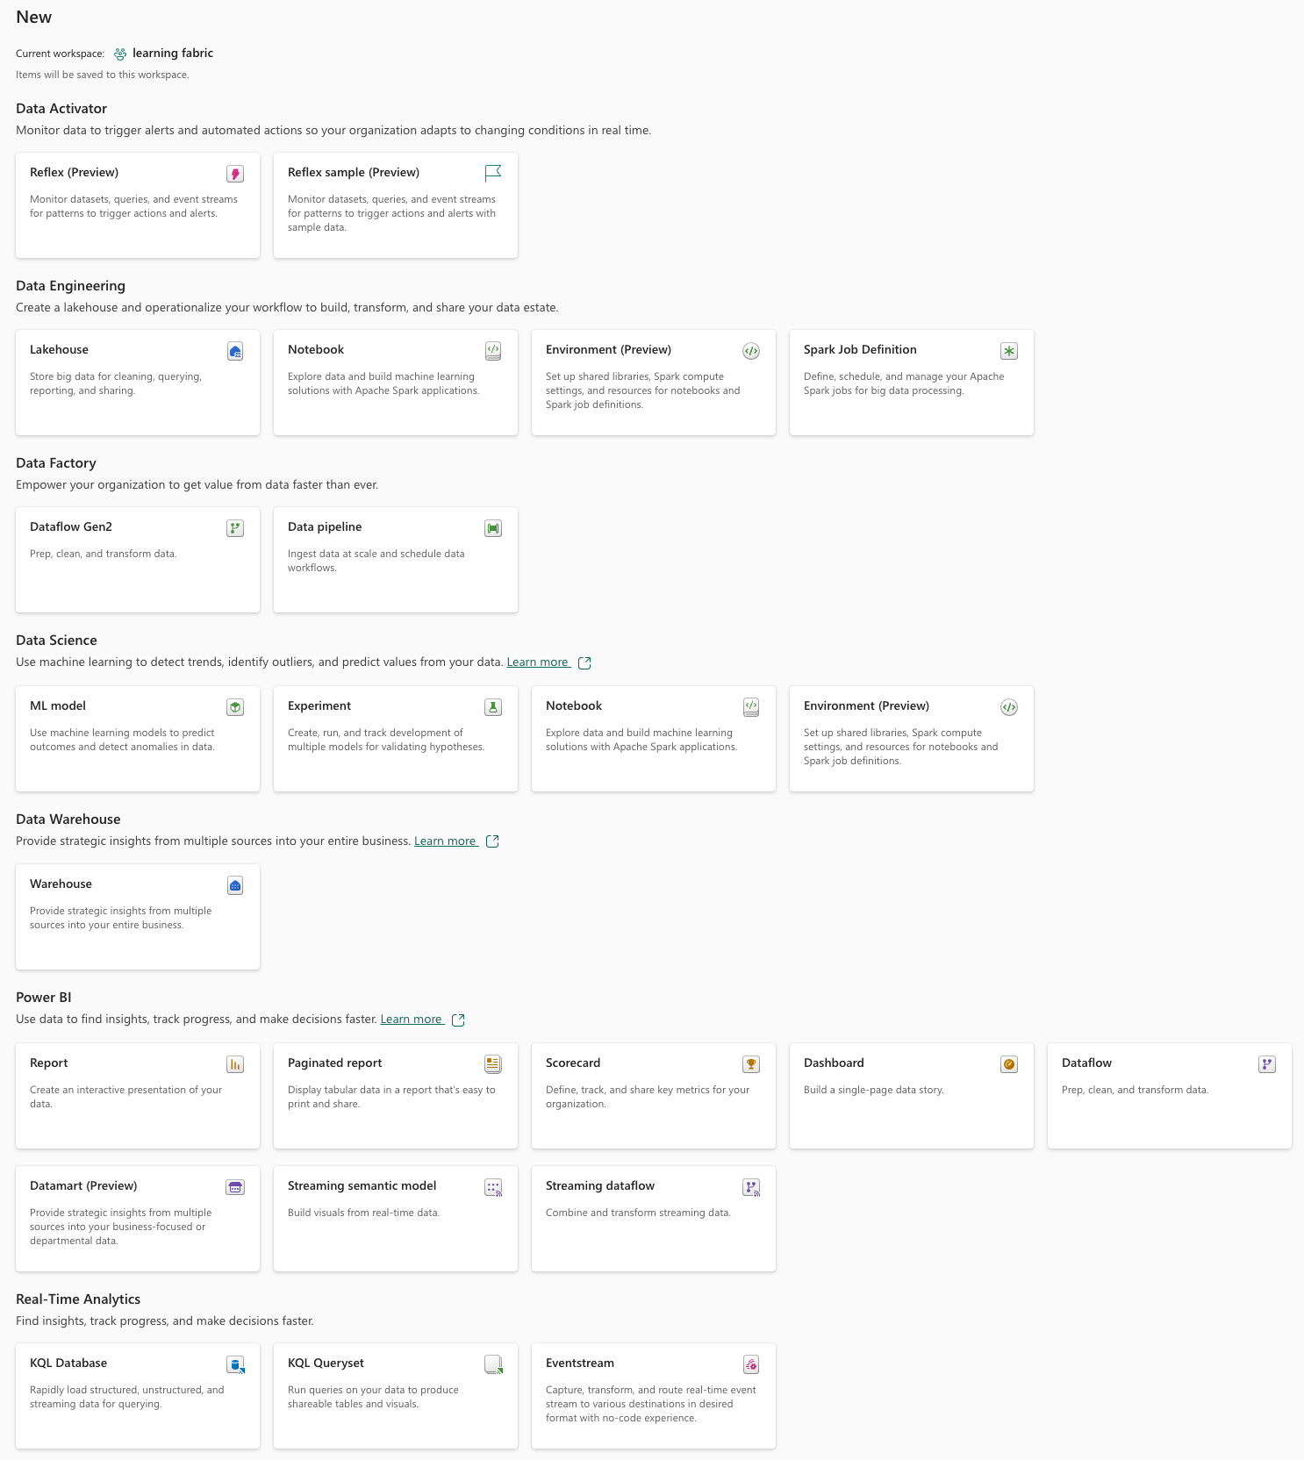
The Microsoft Fabric cosmos
The amazing things we can create now and that will be stored inside a workspace (so much more than a simple container)!

Slide 12
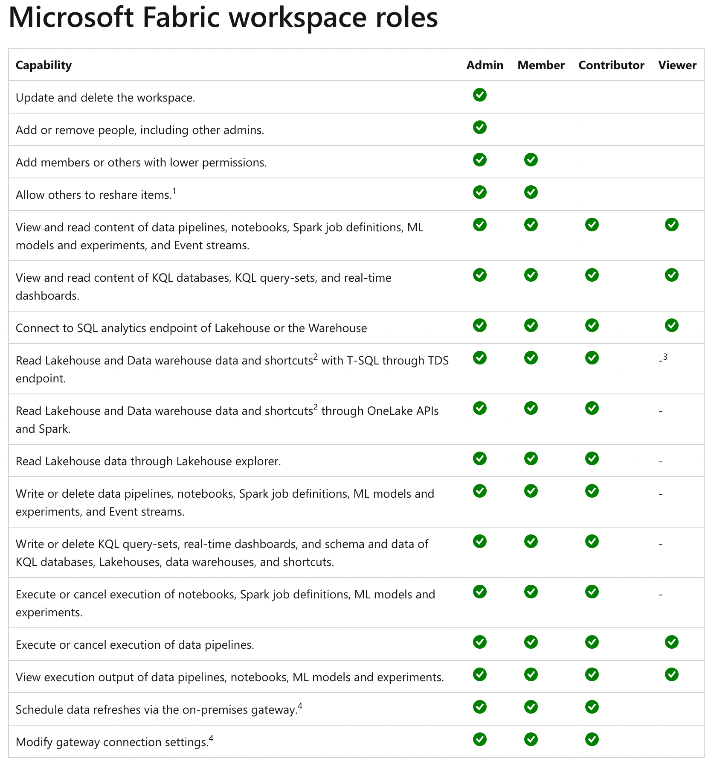
The Microsoft Fabric cosmos

Slide 13




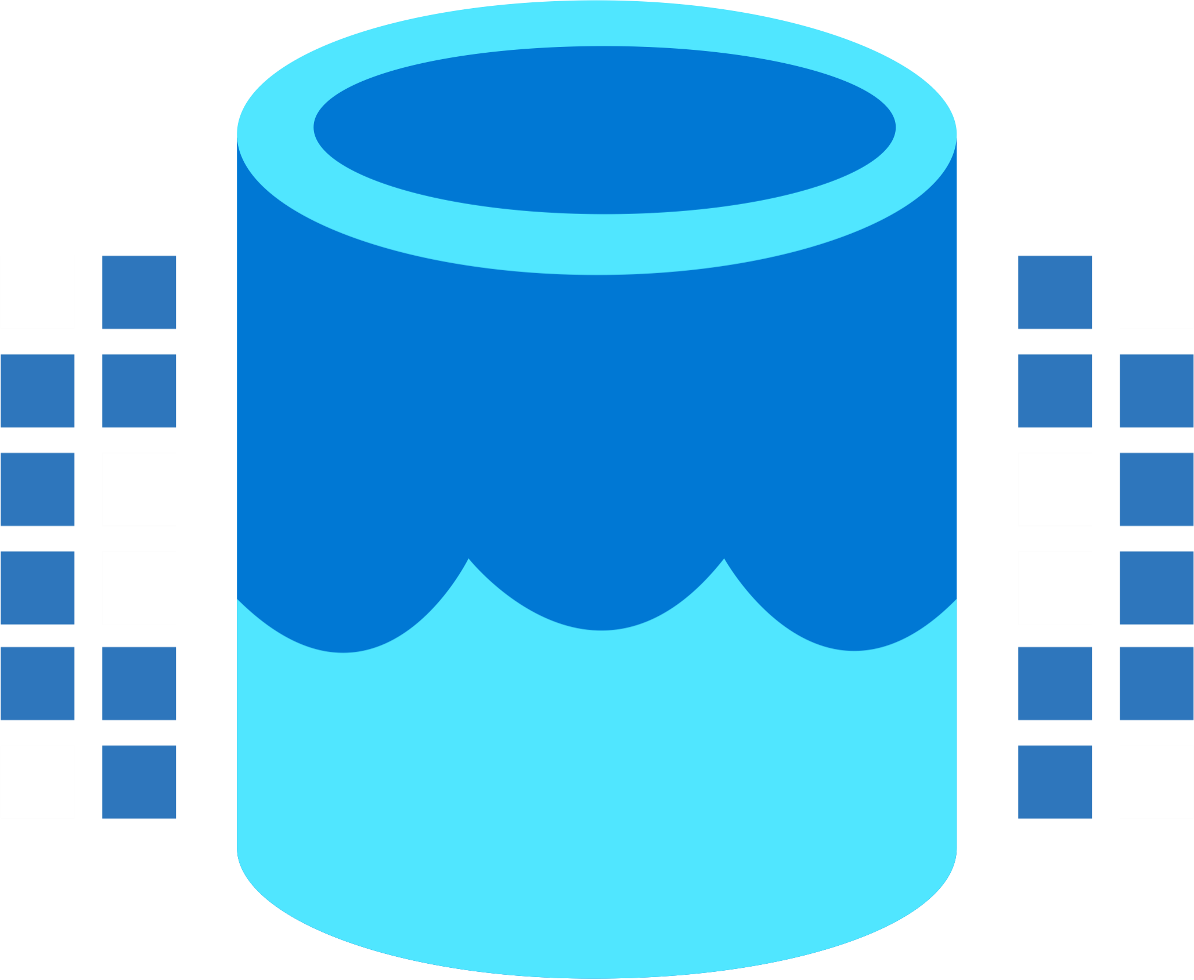

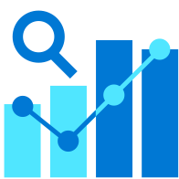

Our team is growing
Data Integration
Data Lake
Spark Engines
Data Lakehouse/
Warehouse
Real Time Analytics
Data
Science
Business
Intelligence
Governance
End-to-end analytics data fabric - From the data lake to the business user

Slide 14
Our team is growing
Data Integration
Data Lake
Spark Engines
Data Lakehouse/
Warehouse
Real Time Analytics
Data
Science
Business
Intelligence
Governance
End-to-end analytics data fabric - From the data lake to the business user

Slide 15
Our team is growing
Data Integration
Data Lake
Spark Engines
Data Lakehouse/
Warehouse
Real Time Analytics
Data
Science
Business
Intelligence
Governance
End-to-end analytics data fabric - From the data lake to the business user

Slide 16
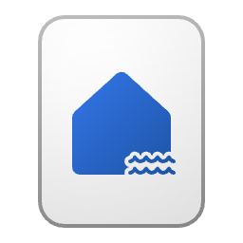
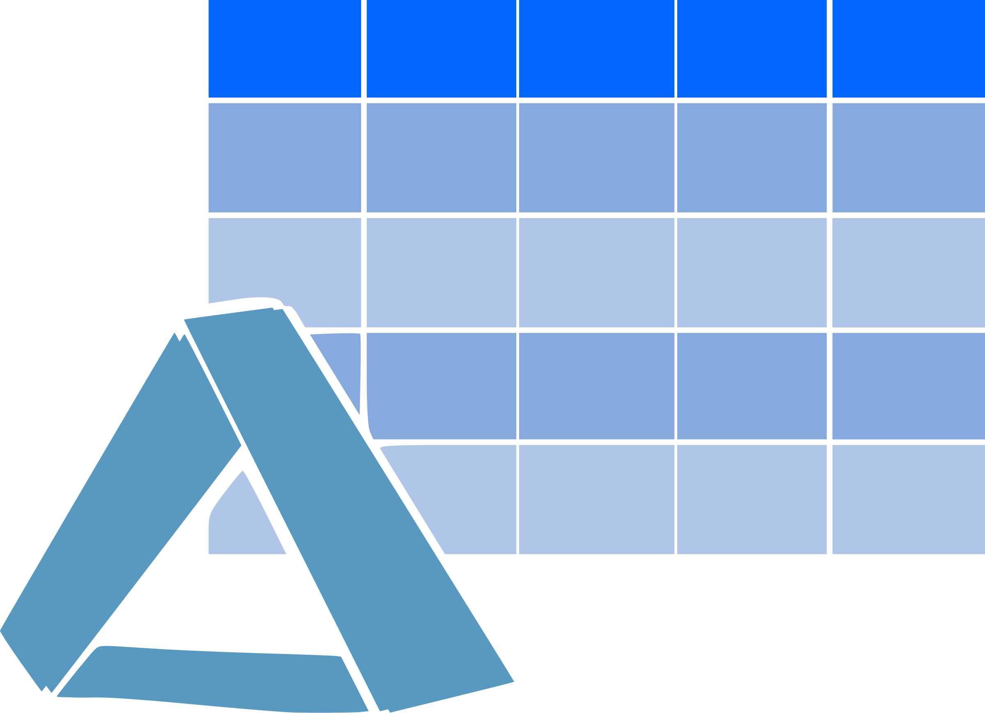

Our team is growing
The Lakehouse – Medallion architecture
Using dedicated workspaces for different workloads helps us to keep our items separate between different workloads and, for this reason, safe from accidental harm.
Next to that, it provides many more advantages, e.g. spreading workloads across capacities
Bronze (Landing Zone)
Silver
Gold (Business level aggregates)
Data
Science

Slide 17
Now, how to get our items safe
A gentle introduction to some of the many Azure security capabilities

Slide 18
Some words about Azure securit
Authentication
MFA
Conditional Access (the managed device)
Authorization

Slide 19



Some words about Azure securit
Connecting to delta tables is simple, leveraging the Power of Fabric shortcuts, but maybe not easy ☺

Slide 20

Some words about Azure security
Connecting to delta tables is simple, leveraging the Power of Fabric shortcuts, but maybe not easy ☺
Fabric needs access to the delta tables that may reside behind a firewall rule

Slide 21
Some words about Azure security
Connecting to delta tables is simple, leveraging the Power of Fabric shortcuts, but maybe not easy ☺
Fabric needs access to the delta tables that may reside behind a firewall rule.
The Fabric workspace becomes an identity that can be registered with the storage account (https://learn.microsoft.com/en-gb/fabric/release-plan/admin-governance#fabric-azure-storage)

Slide 22
Some words about Azure security
These are only two of the many security features that come with Azure!

Slide 23
Use SQL security features of the Data Warehouse item …

Slide 24
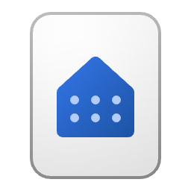
Using T-SQL to restrict access on objects
The data owning workspace
Use SQL commands in the data owning workspace to restrict access like
DENY SELECT ON OBJECT::dbo.DimDate TO [mvp@minceddata.com];
The data modeling workspace
Synapse Data Engineering

Slide 25
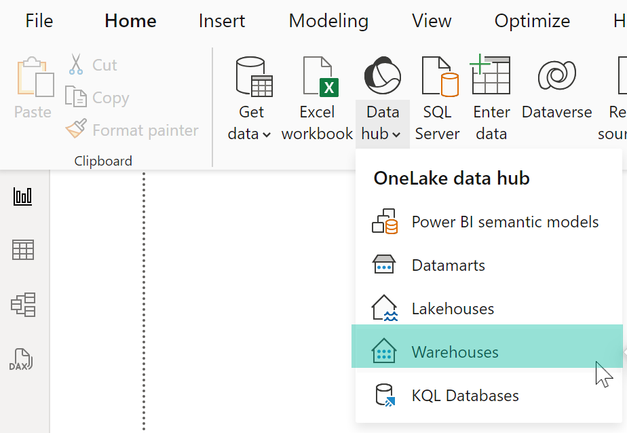
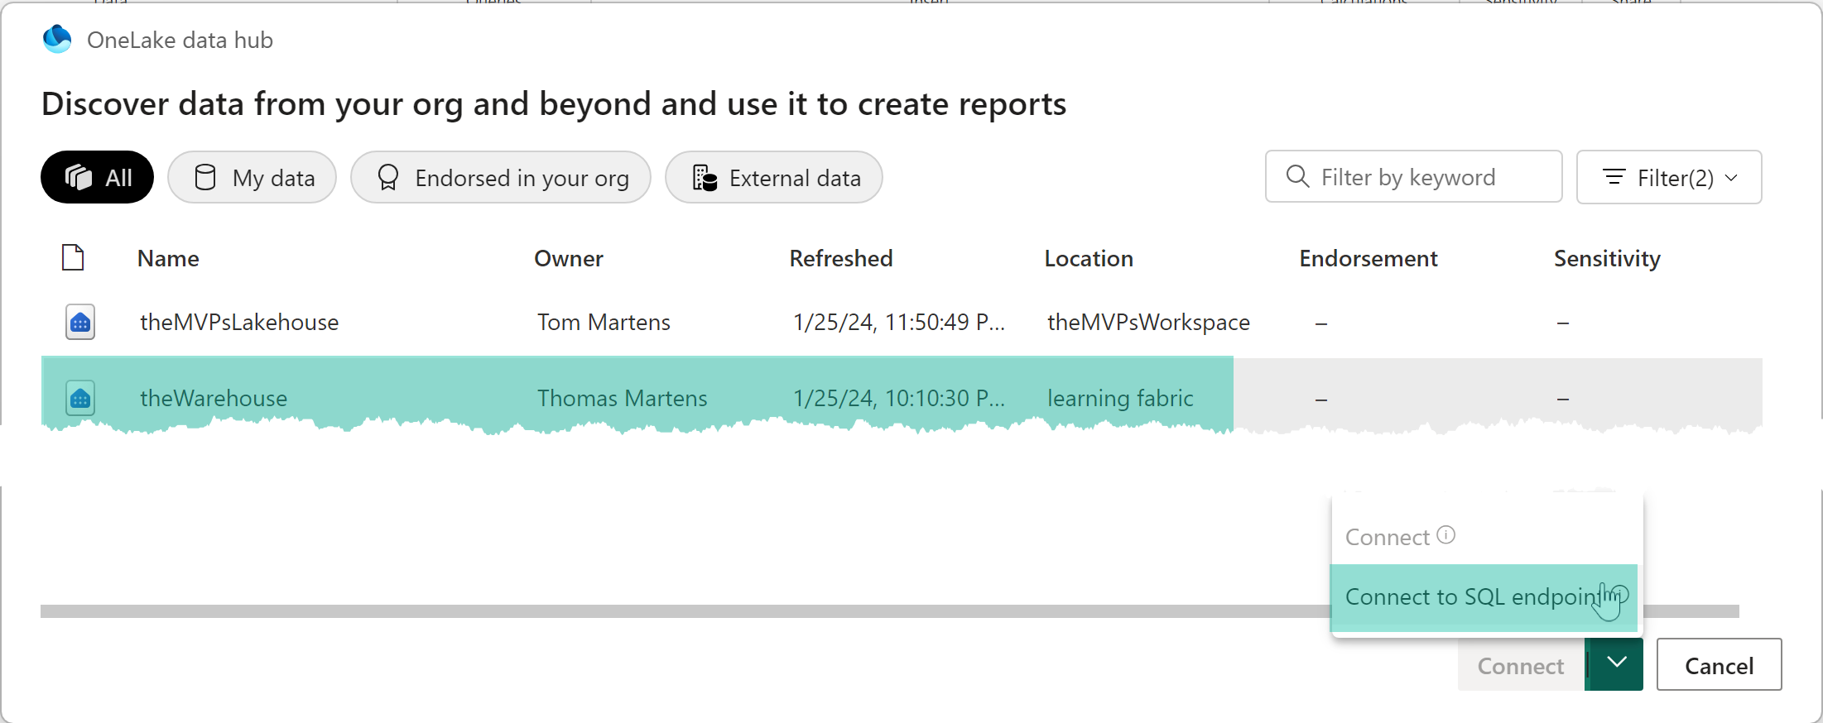
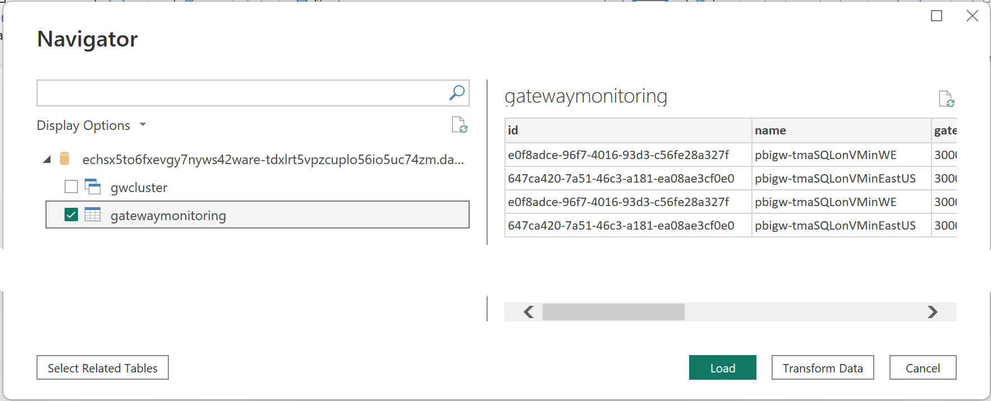
Using T-SQL to restrict access on objects

Slide 26
Using T-SQL to restrict access on objects
This time it’s simple and easy
Share access to the SQL endpoint of the Warehouse
Restrict Access using T-SQL

Slide 27
… until OneLake security arrives (another game changer)
https://learn.microsoft.com/en-gb/fabric/release-plan/onelake#onesecurity

Slide 28
OneLake security (another game changer)
OneLake security model for tables and folders (public preview)
Estimated release timeline: Q2 2024
Managing data security across multiple analytical engines and copies of data is challenging. OneLake and Fabric simplify this by enabling the use of a single data copy across multiple analytical engines without any data movement or duplication. Taking the "one copy" concept further, OneLake is also enhancing security with a finer-grain model, allowing direct security for tables and folders. These security definitions live with the data and travel across shortcuts to wherever the data is used. Security defined at OneLake is universally enforced no matter, which analytical engine is used to access the data.
https://learn.microsoft.com/en-gb/fabric/release-plan/onelake#onesecurity

Slide 29
Useful links
Fabric workspace roles: https://learn.microsoft.com/en-us/fabric/get-started/roles-workspaces

Slide 30
Resources to study more

Slide 31
Thank you
Connect to me at:
Stay online for my live Q&A sessions after the repeat of the session
/tommartens68
@tommartens68

